Slide 1
An Introduction to Programming with Python
Meifeng Lin
Computational Science Initiative
BNL Winter Program
January 12, 2017

Slide 2
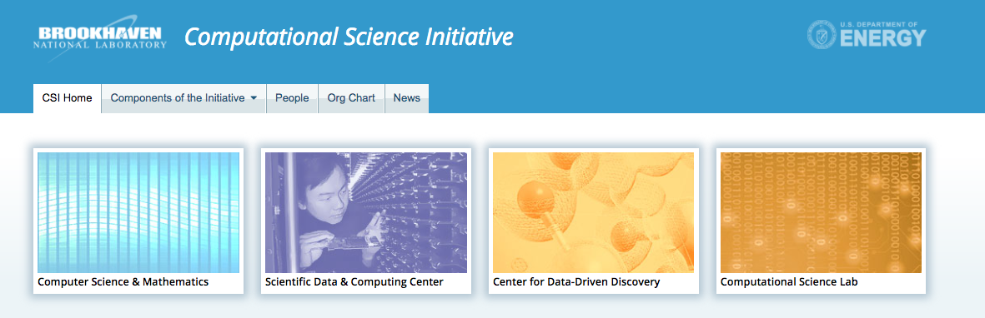
Who am I?
I am a computational scientist at the BNL Computational Science Initiative (CSI). www.bnl.gov/compsci
I am also a physicist performing theoretical research in particle physics. But really I am doing a lot of computer simulations.
Columbia -> MIT -> Yale -> BU -> ANL -> BNL

Slide 3
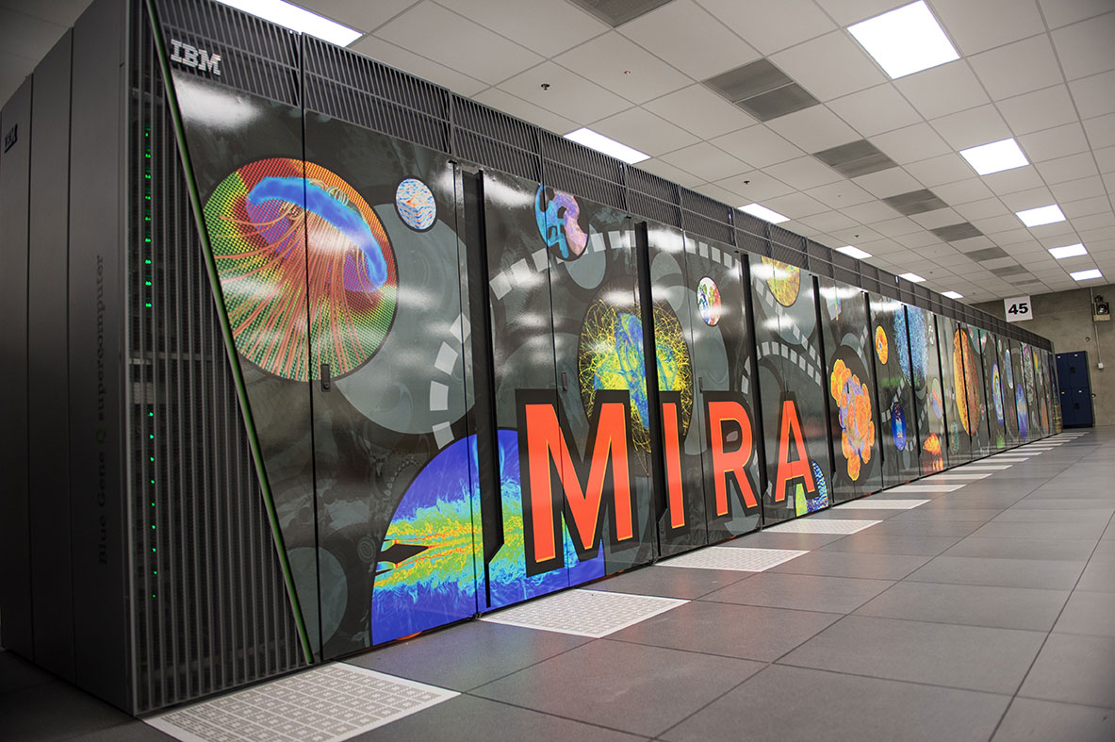
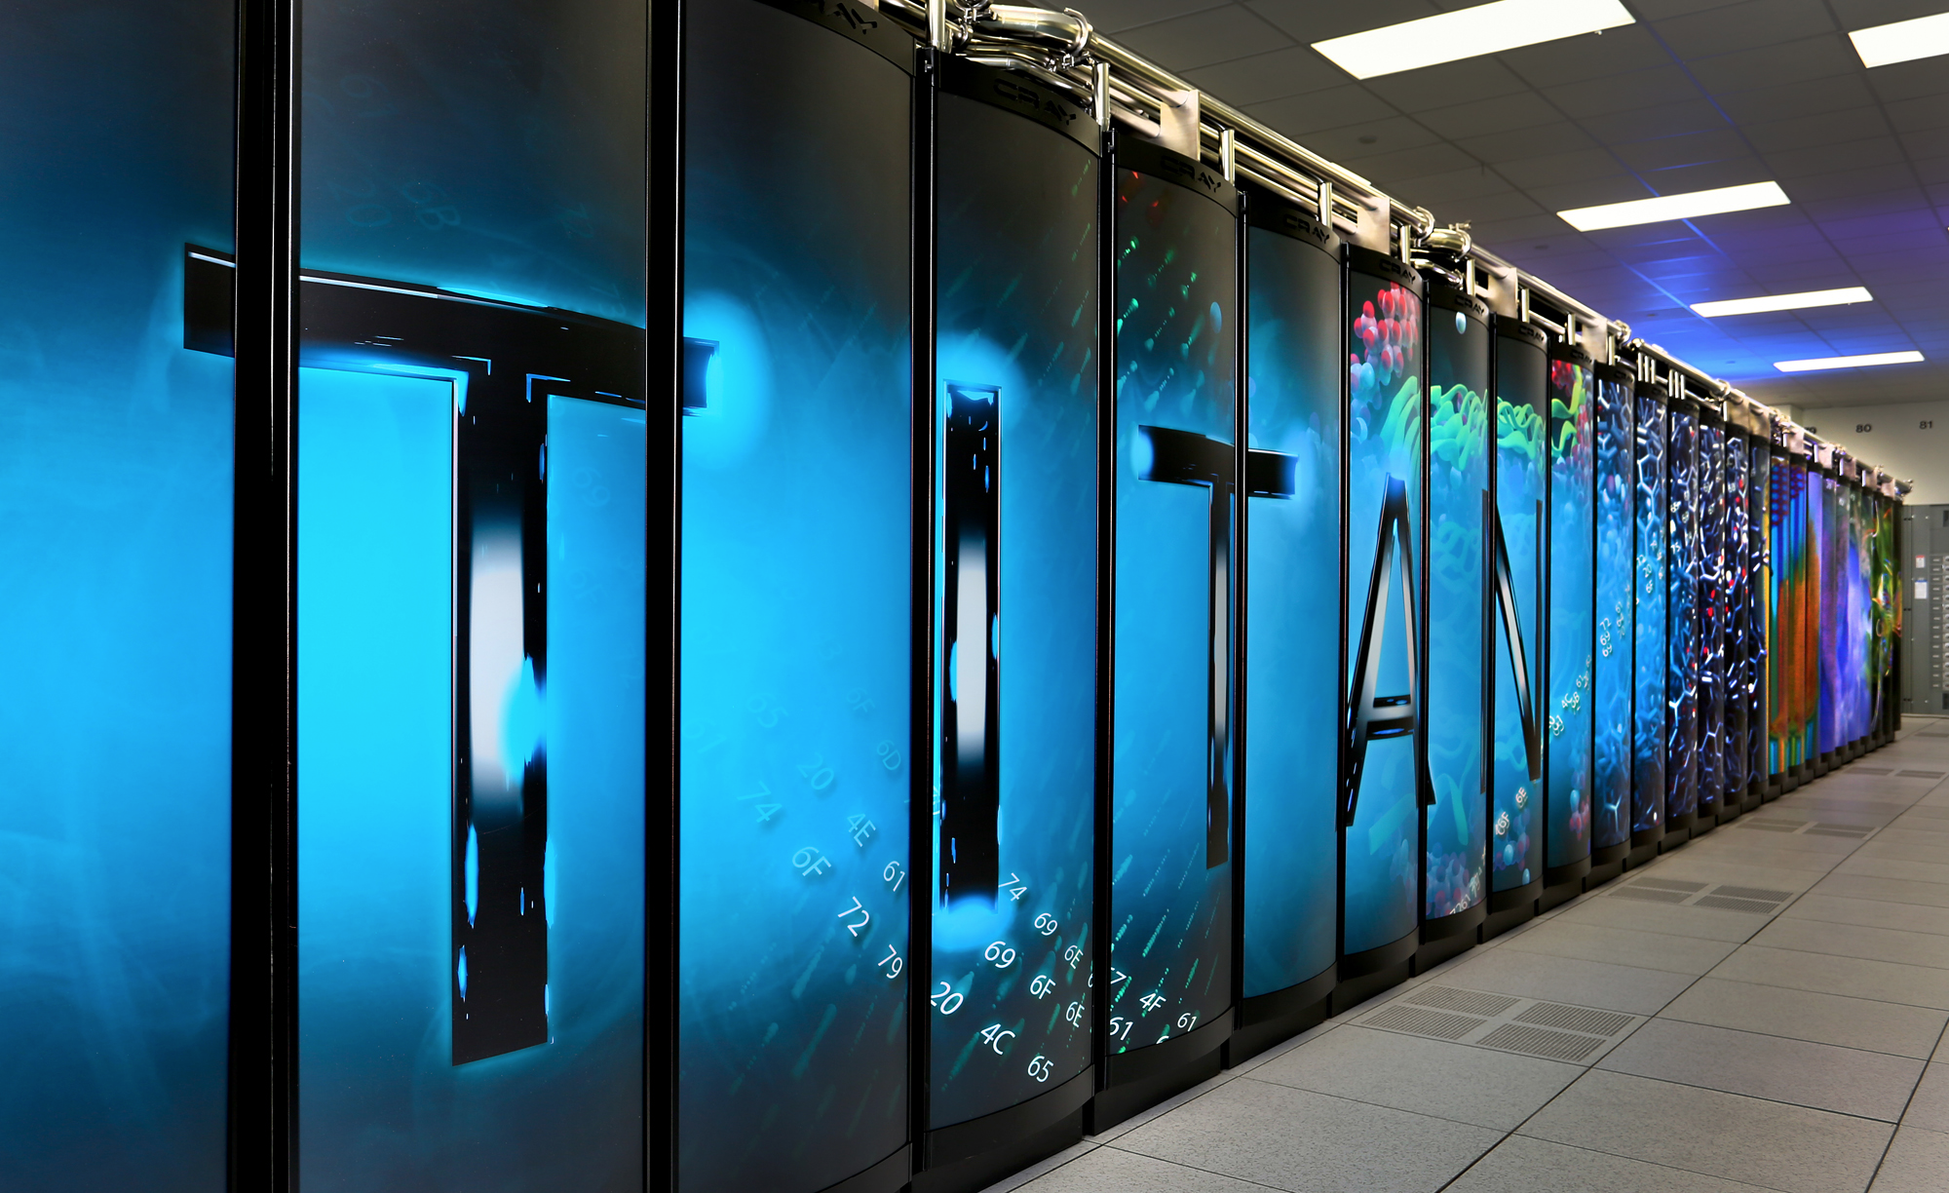
What Do I Do?
Physics: Study the fundamental interactions between the sub-atomic particles called quarks and gluons.
Empty Space is NOT Empty.
https://www.youtube.com/watch?v=J3xLuZNKhlY
Computing: Program and run on some of the most powerful supercomputers in the world
Data Analysis: Turn the data into meaningful physical results.

Slide 4


What is Programming?
Here programming is short for “computer programming”, aka “coding”.
Coding is writing a set of instructions for the computers.
For most of us, this means writing a human-readable program which is then transformed to machine codes that the computer can understand and execute.
But programming goes beyond simply coding, as it also involves analyzing the problem, coming up with a suitable algorithm and designing the implementation strategies etc.
Compiler
Interpreter
Assembler
Image source: http://aquinashub.co.uk/
Image Source: http://ipoint-tech.com/

Slide 5
What is a programming language?
Just as we have different human languages, there are a lot of different computer programming languages, such as FORTRAN, C, C++, Python, Java, Perl, etc.
When I was in high school, I learned BASIC!
A programming language defines a set of rules to write a computer program.
Just like a human language, a programming language has a certain “vocabulary” and “grammar”.

Slide 6
Why do we need to know about programming?
Programming is embedded in every aspect of modern life.
Computers.
Playstation, XBOX, ...
Smart phones/TVs/watches/refrigerators/...
How are they smart? Computer programs!
Smart houses? (Eureka, anyone?)

Slide 7
In the Context of Science and Engineering…
Numerical simulations and big data analytics play a significant role in the advancement of science and engineering.
Programming is essential…
Aircraft simulation
Genome sequencing
Drug discovery
Supernova simulation
The origin of mass and the evolution of the universe!
And much more…

Slide 8
Introduction to Python

Slide 9
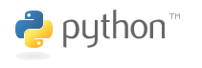
What is Python?
www.python.org
Python is a popular computer programming language with many applications.
It is a high-level language that is meant to be very readable, flexible and portable across different platforms (Mac OS, Windows, Linux, …).
It is an interpreted language, meaning, the program statements are checked statement by statement.
Needs the python interpreter.
No need to compile and link the program, unlike C/C++.

Slide 10
Lesson Plan
Python Basics with Demonstration [45 minutes]
We’ll use Canopy for demonstration in class.
More experienced users feel free to use your own installation of python.
Hands-On Exercises [75 minutes]
Generate random numbers
Calculate average and standard deviation
Monte Carlo methods

Slide 11
My Goals for this course
Introduce you to the world of programming
Give you a taste of flavors of Python
Hopefully can motivate you to learn more about python and computer programming in general.

Slide 12

Starting up Canopy
If you have Canopy installed on your own laptop, double click the launcher.
Something like this
On the Amazon Cloud Remote Desktop, simply click the “Enthought Canopy” icon on the desktop.
You will be asked to do some setup the first time you run Canopy. For most of you, choosing the default should suffice.

Slide 13
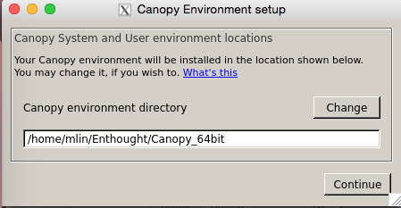
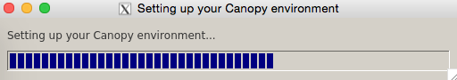
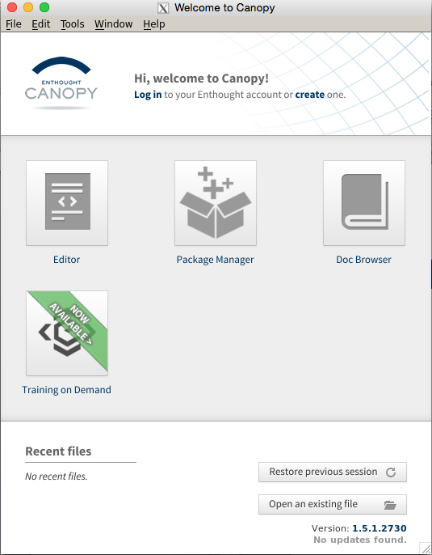
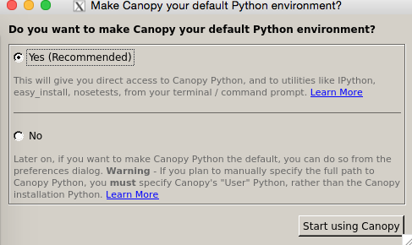
Setting up Canopy
1
2
3
4

Slide 14
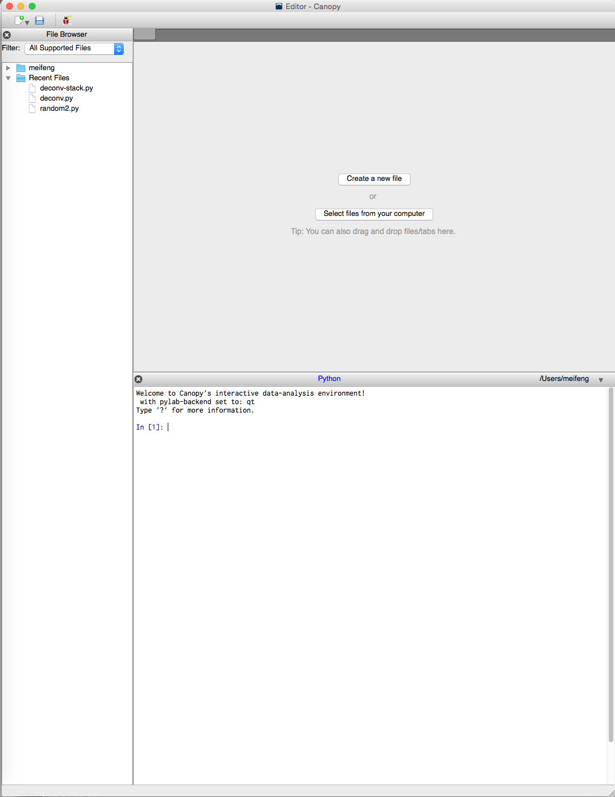
text editor
the IPython shell
An enhanced interactive python shell.

Slide 15
Standard Python Shell vs. IPython
The standard python shell
Barebones interpreter
This is what you get with the standard Python distribution.
IPython -- An advanced python shell
Tab completion of variable names
Supports some Unix/Windows commands
Inline documentation
Syntax highlighting
Good for beginners

Slide 16
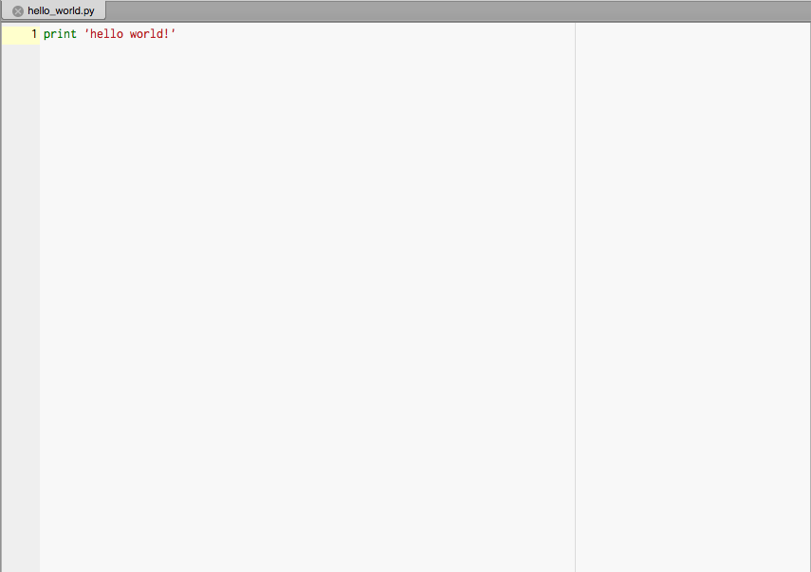
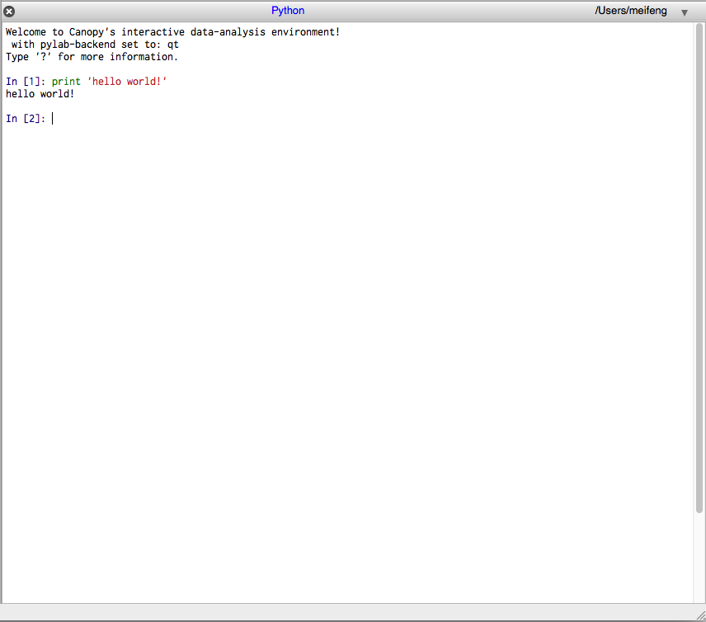
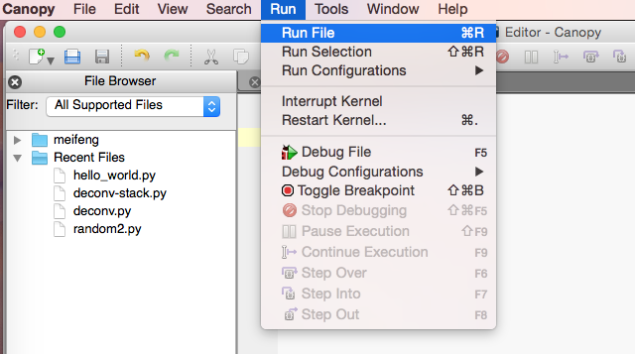
Two Ways to Use Python
Interactive mode
Script mode
Good for prototyping code segments or as a calculator.
Or in terminal: python hello_world.py

Slide 17
Good to know
There are two major releases of Python: Python 2.x and Python 3.x
Python 3.x is not backward compatible. So make sure you know which version you are using.
If you are using a terminal, you can check by running:
python --version
In the interactive mode, you can check with
print sys.version
On the Amazon RD, it should return:
Python 2.7.11 -- 64-bit
We will be using Python 2.x.

Slide 18
Good to know
Code blocks are organized by indentation
Single-line comments start with #
Multiline comments start and end with matching ``` (three single quotation marks) or “”” (three double quotation marks)
Comments are ignored by the interpreter, except when the first line begins with #!
#!/usr/bin/python
It tells the Operating System (OS) that the program is to be processed by /usr/bin/python.
Demo: hello_world.py

Slide 19
Python Basic Building Blocks
Data Types: int, float, str, long, bool,…
Variables: variable_name = value
Collection Data Types: tuples, lists, sets, dictionaries
Logical Operators: ==, >, <, and, or, not, in
Arithmetic Operators: +, -, /, *, **, %, …
Input / Output: input/raw_input, print, open, close
Control Flow Statements: if/elif/else, while, for
Creating and Using Functions: def, import
Other programming languages have more or less the same components, with different syntaxes.
Notes:
Data Types: int, float, str, long, bool (only two values: True or False),…
Can check the data type with type(value)

Slide 20
Data Types
Built-in data types:
int positive or negative whole numbers, e.g. 5, 100, -2
float decimal numbers, 1.2, 3.14159, -10.0
str ‘hello’, “This is a string”
bool Only two values of this type: True or False
Useful Utilities
type(some_value or variable)
sys.float_info
sys.maxint
Type conversion:
float(2) -> 2.0,int(1.1) -> 1
Be careful: 2/3 -> 0. Make sure one of them is a float.
Note: You can also have user-defined data types: classes, which we are not going to cover.

Slide 21
Variables and Assignment
Assignment
s = ‘hello world!’
Variable
Value
Variables have to be in one word. Can’t start with a number, but otherwise can be any combinations of numbers, letters and some special characters: _ and -.
my_variable, var1, var2, …
Can’t be any of the Python reserved words, such as if, else, True, False, class, etc.
Assignments can also be
a, b = 1.0, 2.2 -> a = 1.0, b = 2.2

Slide 22
Collection Data Types: Represent a group of values
List
name = [‘Alice’, ‘Bob’, ‘Charlie’, ‘David’],
age = [20, 22, 23, 21]
List is mutable (append, remove, insert, …)
indexing, slicing
len(a), range([start,]stop[,step])
Dictionaries: associative key:value pairs
age={‘Alice’:20, ‘Bob’:22, ‘Charlie’:23, ‘David’:21}
Indexing: age[‘Alice’]
Insertion: age[‘Edward’] = 19
In random order by default. Try: print age
Tuples
Results = (1.1, 2.0)
Not mutable. Can have mixed data types, nested tuples.
Sets:
set1={1,2,3,4}, set2={2,3,4,5}
set1&set2 -> {2,3,4}

Slide 23
Logical Operation
Returns True or False
Demo
==
<, >
and
or
not

Slide 24
Arithmetic Operators
Demo: +, -, *, /, **, %
**: power
%: modulo
Order of executions
When in doubt, use parentheses

Slide 25
Input and Output (I/O)
Standard I/O (Prints to screen, or takes input from keyboard)
print
input – automatically detects the type based on the input
raw_input – everything is considered a string.
Hint: check using type(arg)
File I/O (demo in examples)
open (returns a file handle)
Infile = open(‘mydata.dat’,’r’)
Outfile = open(‘output.dat’,’w’)
read, readlines, readline, for line in f:
write
close

Slide 26
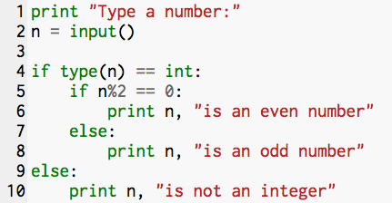
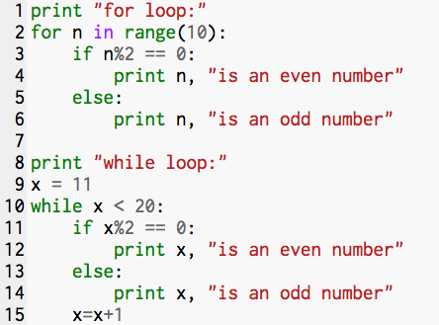
Control Flow Statements
Conditional: if/elif/else
Only execute if the statement is True
Can have nested conditionals
Looping: for, while

Slide 27
Functions
Functions have the form func([argument list])
Examples: sqrt(2), sin(pi), range(1,100,2), etc.
In addition to the built-in functions, we can also define our own
def my_func(arg1, arg2):
do something
return results
For example:
def square(x):
return x*x
print square(2)

Slide 28
Classes, Modules and Libraries
The true power of Python lies in the vast collection of open-source modules and libraries that are freely available.
Python comes with limited built-in functions. To use the external modules and functions, we have to let python know beforehand.
Ways to access external functions
import module_name
For C programmers, this is much like #include<header.h>
from module_name import func
Example:
import math
math.sqrt(2)
from math import sqrt
sqrt(2)

Slide 29
An Example – Random Numbers
Task 1
Generate N normally/Gaussian distributed random numbers with an average of μ (mu) and standard deviation σ (sigma)
Write them to disk
Task 2
Read them back in
Compute the average and standard deviation
Display the results on terminal
Task 3 (Time permitting)
Compute and display the histogram of the numbers
Do a curve fit

Slide 30
Normal/Gaussian Distribution
From Wikipedia:
A normal distribution is:
The parameter μ in this definition is the mean or expectation of the distribution (and also its median and mode). The parameter σ is its standard deviation; its variance is therefore σ². A random variable with a Gaussian distribution is said to be normally distributed and is called a normal deviate.
If μ= 0 and σ = 1, the distribution is called the standard normal distribution or the unit normal distribution

Slide 31
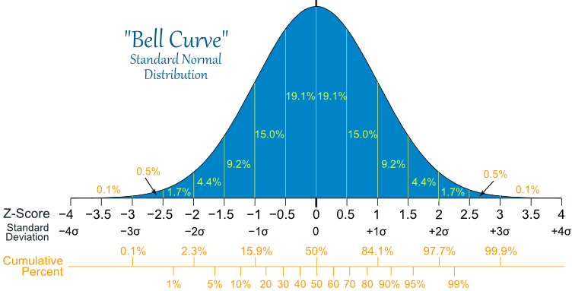
Normal/Gaussian Distribution
Image source: http://www.mathsisfun.com

Slide 32
Task1: Generate and save the random numbers
Code demo: generate.py
Features demonstrated:
Import external functions
Assignments
List operation
For loop
File output

Slide 33
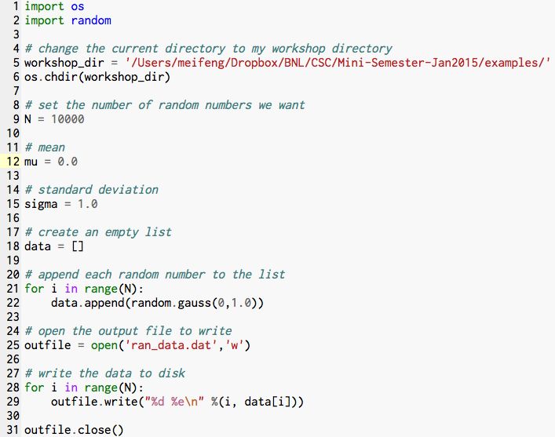

Slide 34
Statistical Analysis of Data
We can calculate the mean and standard deviation of the random numbers we just generated, and compare them to the input values: μ = 0, σ = 1.0
Mean:
Standard deviation:

Slide 35
Task2: Calculate the mean and standard deviation
Code demo: analyze.py
Features demonstrated:
File input
User-defined functions
Type conversion

Slide 36
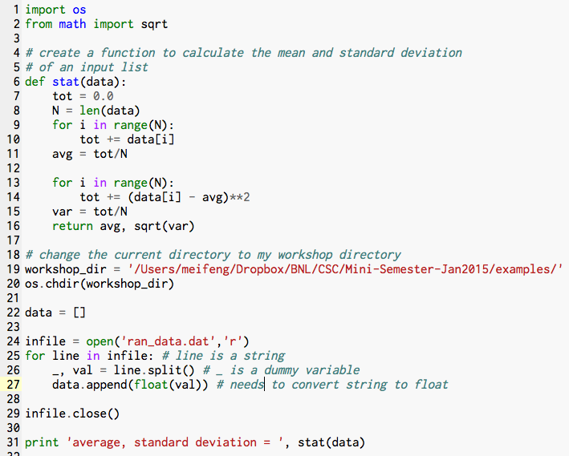

Slide 37
Histogram
A histogram is a graphical representation of the distribution of data.
The histogram of the random numbers we generated should be an approximation of the normal distribution.
The more data we generate, the closer our histogram is to the normal distribution.

Slide 38
Task3: Fit the data and plot the histogram
Code demo: fit.py
Features demonstrated:
Use of external libraries: numpy, scipy and matplotlib
Plotting
Curve fitting with scipy

Slide 39
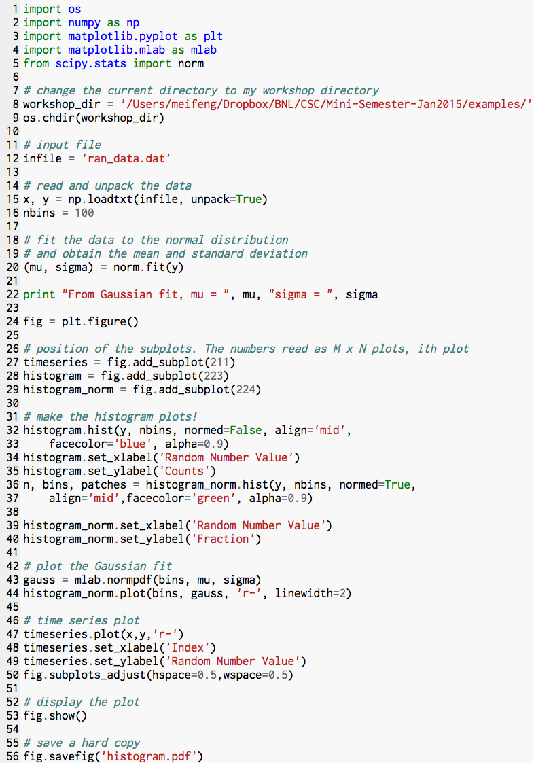

Slide 40
Hands-On Exercises

Slide 41
Exercise #1
Print numbers 1 to 100 to stdout
Elements needed:
print
range function
for loop

Slide 42
Exercise #2
Print 100 random numbers in the format of:
<index> <random number>
New Elements needed:
from random import random
random() will generate one flat-distribution random number between [0,1]

Slide 43
Statistical Analysis of Data
Mean:
Standard deviation:

Slide 44
Exercise #3
Write a function to calculate the mean and standard deviation of a list
Calculate the mean and standard deviation of the generated random numbers
New elements needed:
Store the random numbers in a list
Self defined function: def func()
The sqrt function from the math module

Slide 45
Exercise #4
Monte Carlo Methods: numerical methods that use random numbers to do repeated sampling and obtain results.
Estimate the value of π using the Monte Carlo method.
Area of the square: 4r²
Area of the circle: πr²
If we throw darts randomly at the square, the probability of them landing inside the circle is π/4
Monte Carlo estimation of π:
Generate N points with coordinates (x, y), where x and y are random numbers between 0 and 1
If sqrt(x^2 + y^2) < 1, N_{in} = N_{in} + 1
N_{in} / N = π / 4 ➔ π = 4 N_{in} / N
r

Slide 46
Closing Remarks
Python is powerful and fun.
It’s a good first language to learn if you don’t have any programming experience.
You can find many useful resources on the internet.
Official Python website: www.python.org
Online video courses:
www.udacity.com
www.coursera.org
www.edx.org
Codecademy interactive coding tutorials:
http://www.codecademy.com/tracks/python

Slide 47
print “Have fun coding!”

